Slide 1
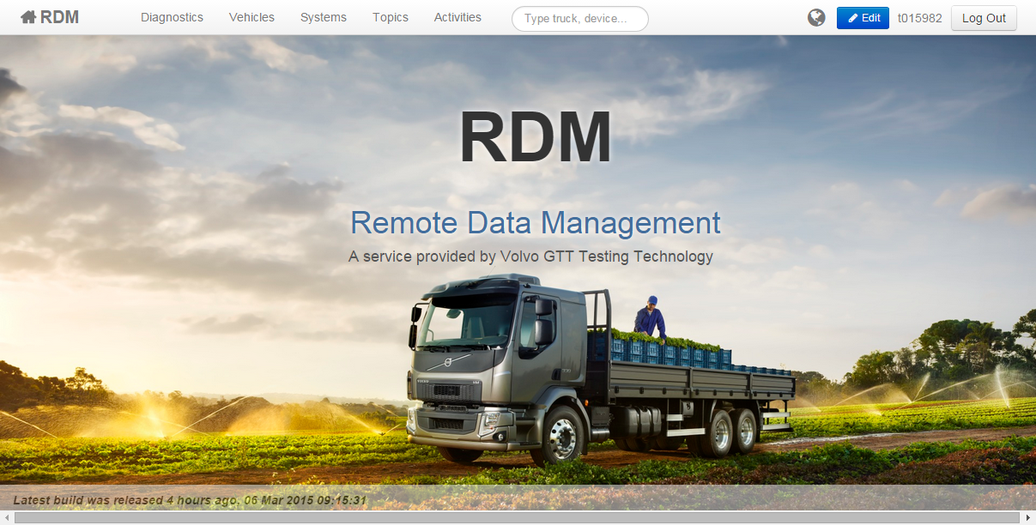
http://rdm.srv.volvo.com
Hagerstown
2016-09-08

Slide 2
RDM (Remote Data Management)
RDM Core Team
Magnus Hansson, Global Virtual and Physical Testing Technology, GOT
Therese Willforss, Rig and Testing Technology , GOT
Developing the RDM Application, Communication and related hardware:
Logger
COM Gateway
Maintaining and supports local installations worldwide (BLR, GOT, GSO, CUR, LYS, (AGO))
System operation managed by Volvo Group IT
.

Slide 3
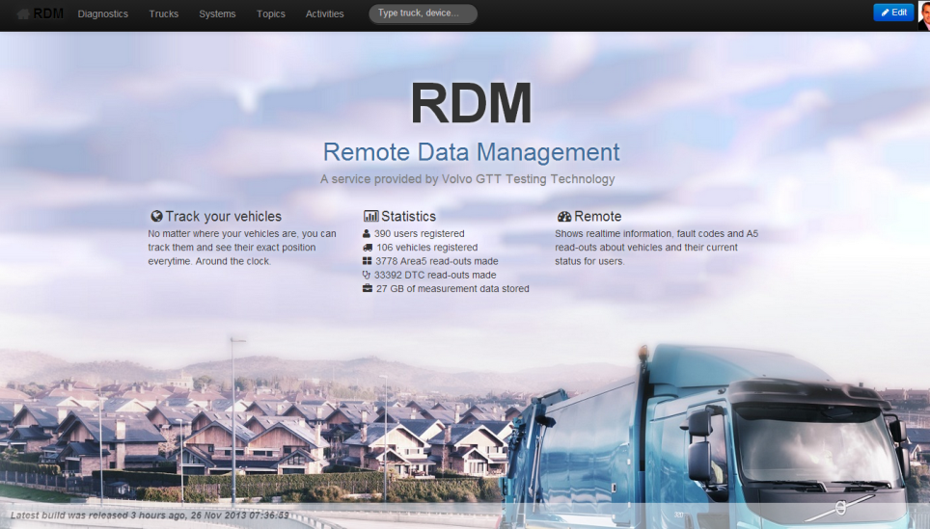


http://rdm.srv.volvo.com
Web Browser information:
Mozilla FireFox
Recommended
Working fully with RDM.
Can be ordered via FAROS
Google Chrome
Working fully with RDM (you need to have MyPlace open client)

Slide 4
RDM (Remote Data Manager)
Scope
A comprehensive system and infrastructure solution used for requesting, retrieving and processing information (data) from field test trucks running in different markets.
Description
- Based on the previous CANSAS application, replacing the RAPIDO logger unit
- Positioning (GPS, Fleet mgmt.)
- Fault codes (DTC (Diagnostic Trouble Codes), DM-1 (Diagnostic Messages)),
- Area5 data (EMS, ACM), (translated and presented in TXT-format)
- Logging time signals or traffic measurement
- External logging (sensors or actuators)
- Remote Access through 3G (with secured SSL-VPN developed by Group IT)
- Enable secure access to third party loggers/units
- (Future T2L: Datasets programming EMS or ACM, Software Download)
Logging system is always connected and synchronized with RDM database.

Slide 5
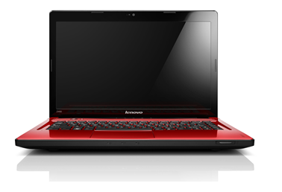
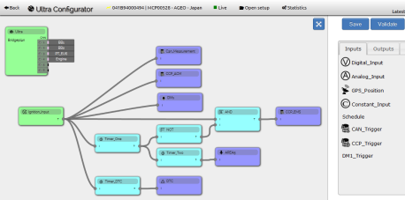
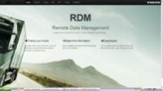

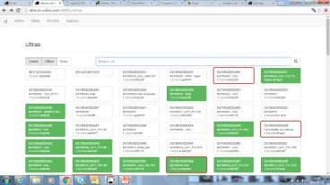


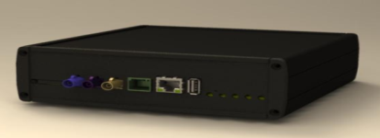
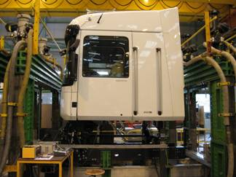

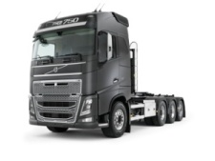
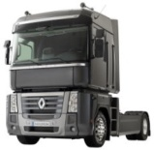
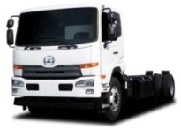
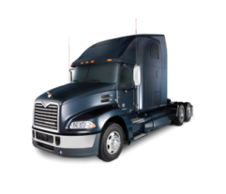

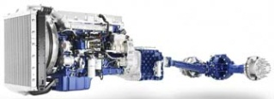
Remote Data Management (today)
Main Components
RDM
Database
PE
ULTRA Web-based Configuration Tool for creating signal setups in RDM
A2l DB
VCS
3G/WLAN
ULTRA Monitoring Tool in RDM
Data Logger

Slide 6

Remote Data Management (Ongoing)
GHOST
Global
Test Data Mgmnt
eFatcs
Protus
Protom
SEWS
Test Collaboration Platform
RDM
Database
PE
ULTRA Web-based Configuration Tool for creating signal setups in RDM
A2l DB
VCS
3G/WLAN
ULTRA Monitoring Tool in RDM
Data Logger

Slide 7


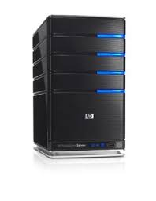


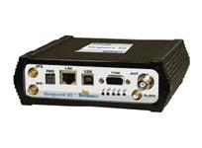
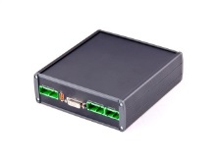



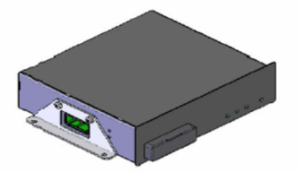
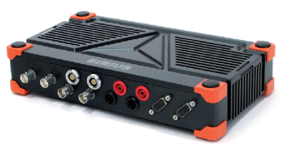
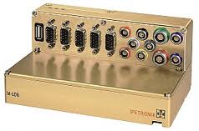
RDM-Web
Remote Data Management (yesterday)
Remote Data Management (RDM-server)
RDM
Database
PE
Distributed Data Collector (DDC)
A2l DB
VCS
VCS
VCS
VCS
ULTRA
MLog
Rapido
Dewesoft

Slide 8
RDM-Web
Remote Data Management (today)
Remote Data Management (RDM-server)
RDM
Database
PE
Distributed Data Collector (DDC)
A2l DB
VCS
VCS
VCS
ULTRA
MLog
Dewesoft

Slide 9
Function List | MLOG | Rapido (not supported) | Ultra (Rapido successor) | RDM support:
Support TEA2 | Y | Y | Y | Y
Support TEA2+ | Y | Y | Y | Y
Support BP (Bridge Plan) | Y | Y | Y | Y
Support Value Truck (P9103) | Y | ? | Y | Y
Signal Measurement (J1939) | 12 channels | 2 Full and 6 Mux | 6 Full | Y
Signal Measurement (CCP-EMS) | Y | Y | Y | Y
Signal Measurement (CCP-ACM) | Y | Y | Y | Y
Signal Measurement (LIN) | Lin conv. | Y | 1 Lin + Lin conv. | N
Signal Measurement (J1587) | Y(conv.) | Y | Y(conv.) | N
Signal Measurement (External) | Y (ATC) | Y (ATC) | Y (ATC) | Y
CAN Traffic Measurement | Y | N | Y | N
DST Download (EMS/ACM) | N | N | N (if needed) | N
DST upload (EMS/ACM) | N | N | N (if needed) | N
MSW Download (EMS/ACM) | N | N | N | N
Area 5 upload (EMS/ACM) | N | Y | Y | Under verification
DTC read-out | N (Under dev.) | Y | Y | Under verification
DTC Reset | N | N | N | N
DM-1 Measurement | Y | Y | Y | Y (translated)
3G/Wlan VCS2.2 communication | Vanguard | Vanguard | Embedded | Y (3G)
Audio | Y | N | Y | N
Video | Y (ext) | N | Y (ext) | N
Modem | N | N | Y (Embedded) | Y
GPS | N | N | Y (Embedded) | Y
Rental cost per week | 1920 SEK | 500 SEK | 960 SEK | Free
TO BE UPDATED

Slide 10


Rigs & Testing Technology contact information
Need help?
In Europe:
Call GOT: +46 31 323 6212 Call LYS: +33 4 72964709
Call GSO: +1 xxx xxxxx
Email: TTSupportGOT@volvo.com (GOT) TTSupportLYS@volvo.com (LYS)
Good ideas? Magnus.hansson@volvo.com

Slide 11
?’s?
Ready for a short walkthru?
http://rdm.srv.volvo.com/

Slide 12




RDM (Remote Data Manager)
Costs
RDM web is a free service for all users within VCN (Volvo Corporate Network) The only cost to consider is the rental cost for hardware platform in field test trucks.
ULTRA: 960 SEK/week
M-LOG: 1920 SEK/week
Activities included in the price are:
Purchase of the system and all its modules,
3G Flat rate cost (Europe)
Installation
Updates - Maintenance.

